Slide 1
CS 590 Algorithm
Chapter 2 Stack, Queues, Lists, and Trees
Source: Goodrich, M. T., & Tamassia, R. (2015). Algorithm Design and Applications. Hoboken, NJ: Wiley.

Slide 2
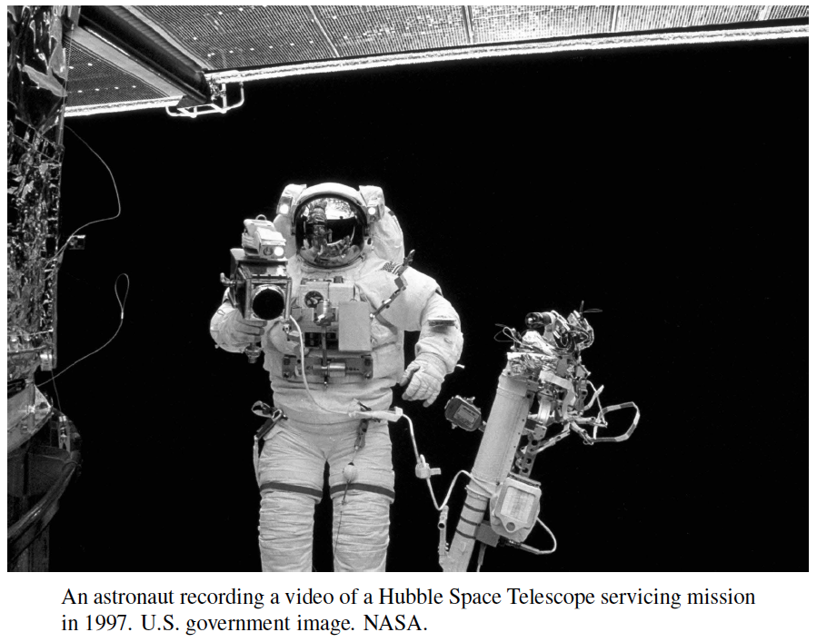
Stacks, Queues, Lists, and Trees
Presentation for use with the textbook Algorithm Design and Applications, by M. T. Goodrich and R. Tamassia, Wiley, 2015

Slide 3

Stacks
Let us discuss the structure: Stack.
Insertions and deletions follow the last-in first-out scheme (LIFO)
Think of a spring-loaded plate dispenser
Main stack operations:
push(e): inserts an element, e
pop(): removes and returns the last inserted element
Auxiliary stack operations:
top(): returns the last inserted element without removing it
size(): returns the number of elements stored
isEmpty(): indicates whether no elements are stored

Slide 4
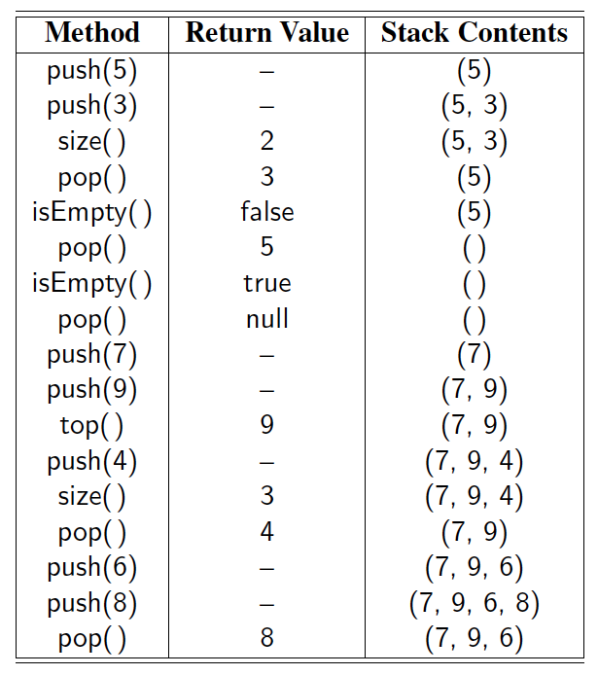
Example

Slide 5
Applications of Stacks
Direct applications
Page-visited history in a Web browser
Undo sequence in a text editor
Chain of method calls in a language supporting recursion
Indirect applications
Auxiliary data structure for algorithms
Component of other data structures

Slide 6
Method Stacks
The runtime environment for such a language keeps track of the chain of active methods with a stack
When a method is called, the system pushes on the stack a frame containing
Local variables and return value
Program counter, keeping track of the statement being executed
When a method ends, its frame is popped from the stack and control is passed to the method on top of the stack
Allows for recursion
main() { int i = 5; 3 foo(i); }
5 foo(int j) { int k; k = j+1; 8 bar(k); }
10 bar(int m) { … }
bar
PC =10 m = 6
foo
PC = 8 j = 5
k = 6
main
PC = 3 i = 5

Slide 7
Array-based Stack
A simple way of implementing the Stack ADT uses an array
We add elements from left to right
A variable keeps track of the index of the top element
Algorithm size()
return t + 1
Algorithm pop()
if isEmpty() then
return null
else
t ← t − 1
return S[t + 1]
…
S
0
1
2
t

Slide 8
Array-based Stack (cont.)
The array storing the stack elements may become full
A push operation will then either grow the array or signal an error
Algorithm push(o)
if t = S.length − 1 then
signal stack overflow error
else
t ← t + 1
S[t] ← o
…
S
0
1
2
t

Slide 9
Performance
Performance
Let n be the number of elements in the stack
The space used is O(n)
Each operation runs in time O(1)
Qualifications
Trying to push a new element into a full stack causes an implementation-specific exception or
Pushing an item on a full stack causes the underlying array to double in size, which implies each operation runs in O(1) amortized time.

Slide 10
Evaluating Arithmetic Expressions (not in book)
Slide by Matt Stallmann included with permission.
14 – 3 * 2 + 7 = (14 – (3 * 2) ) + 7
Operator precedence
* has precedence over +/–
Associativity
operators of the same precedence group
evaluated from left to right
Example: (x – y) + z rather than x – (y + z)
Idea: push each operator on the stack, but first pop and perform higher and equal precedence operations.

Slide 11
Algorithm for Evaluating Expressions
Slide by Matt Stallmann included with permission.
Two stacks:
opStk holds operators
valStk holds values
Use $ as special “end of input” token with lowest precedence
Algorithm doOp()
x ← valStk.pop();
y ← valStk.pop();
op ← opStk.pop();
valStk.push( y op x )
Algorithm repeatOps( refOp ):
while ( valStk.size() > 1 ∧
prec(refOp) ≤ prec(opStk.top())
doOp()
Algorithm EvalExp()
Input: a stream of tokens representing an arithmetic expression (with numbers)
Output: the value of the expression
while there’s another token z
if isNumber(z) then
valStk.push(z)
else
repeatOps(z);
opStk.push(z)
repeatOps($);
return valStk.top()

Slide 12
Algorithm on an Example Expression
Slide by Matt Stallmann included with permission.
Operator ≤ has lower precedence than +/–
14 ≤ 4 – 3 * 2 + 7
4
–
14
≤
3
*
$
$
4
–
7
$
14
≤
F
+
-2
+
5
+
14
≤
14
≤
2
2
3
*
3
*
6
4
–
4
–
4
–
-2
+
14
≤
14
≤
14
≤
14
≤

Slide 13
Computing Spans (not in book)
Using a stack as an auxiliary data structure in an algorithm
Given an array X, the span S[i] of X[i] is the maximum number of consecutive elements X[j] immediately preceding X[i] and such that X[j] ≤ X[i]
Spans have applications to financial analysis
E.g., stock at 52-week high
X
6 | 3 | 4 | 5 | 2
1 | 1 | 2 | 3 | 1
S

Slide 14
Quadratic Algorithm
Algorithm spans1(X, n)
Input array X of n integers
Output array S of spans of X #
S ← new array of n integers n
for i ← 0 to n − 1 do n
s ← 1 n
while s ≤ i ∧ X[i − s] ≤ X[i] 1 + 2 + …+ (n − 1)
s ← s + 1 1 + 2 + …+ (n − 1)
S[i] ← s n
return S 1
Algorithm spans1 runs in O(n²) time

Slide 15
Computing Spans with a Stack
We keep in a stack the indices of the elements visible when “looking back”
We scan the array from left to right
Let i be the current index
We pop indices from the stack until we find index j such that X[i] < X[j]
We set S[i] ← i − j
We push i onto the stack

Slide 16
Linear Time Algorithm
Each index of the array
Is pushed into the stack exactly once
Is popped from the stack at most once
The statements in the while-loop are executed at most n times
Algorithm spans2 runs in O(n) time
Algorithm spans2(X, n) #
S ← new array of n integers n
A ← new empty stack 1
for i ← 0 to n − 1 do n
while (¬A.isEmpty() ∧
X[A.top()] ≤ X[i] ) do n
A.pop() n
if A.isEmpty() then n
S[i] ← i + 1 n
else
S[i] ← i − A.top() n
A.push(i) n
return S 1

Slide 17
Queues
first-in first out

Slide 18
Application: Buffered Output
The Internet is designed to route information in discrete packets, which are at most 1500 bytes in length.
Any time a video stream is transmitted on the Internet, it must be subdivided into packets and these packets must each be individually routed to their destination.
Because of vagaries and errors, the time it takes for these packets to arrive at their destination can be highly variable.
Thus, we need a way of “smoothing out” these variations

Slide 19
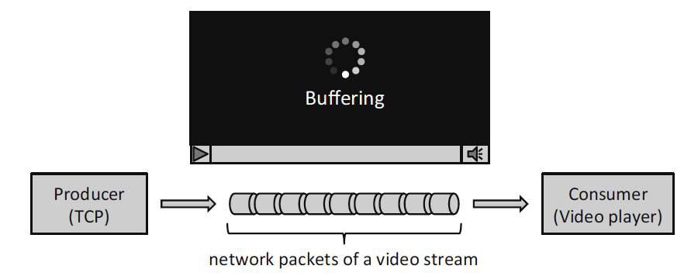
Application: Buffered Output
This smoothing is typically achieved is by using a buffer, which is a portion of computer memory that is used to temporarily store items, as they are being produced by one computational process and consumed by another.
In the case of video packets arriving via the Internet, the networking process is producing the packets and the playback process is consuming them.
This producer-consumer model is enforcing a first-in, first-out (FIFO) protocol for the packets.
A data structure that supports this functionality is called a queue.

Slide 20
Queues
In a Queue, insertions and deletions follow the first-in first-out scheme (FIFO)
Insertions are at the “rear” or “end” of the queue and removals are at the “front” of the queue
Main queue operations:
enqueue(e): inserts an element, e, at the end of the queue
dequeue(): removes and returns the element at the front of the queue
Auxiliary queue operations:
first(): returns the element at the front without removing it
size(): returns the number of elements stored
isEmpty(): indicates whether no elements are stored
Boundary cases:
Attempting the execution of dequeue on an empty queue signals an error or returns null

Slide 21
Example
Operation Output Q
enqueue(5) – (5)
enqueue(3) – (5, 3)
dequeue() 5 (3)
enqueue(7) – (3, 7)
dequeue() 3 (7)
first() 7 (7)
dequeue() 7 ()
dequeue() null ()
isEmpty() true ()
enqueue(9) – (9)
enqueue(7) – (9, 7)
size() 2 (9, 7)
enqueue(3) – (9, 7, 3)
enqueue(5) – (9, 7, 3, 5)
dequeue() 9 (7, 3, 5)

Slide 22
Additional Applications
Besides buffering video, queues also have the following applications:
Direct applications
Waiting lists, bureaucracy
Access to shared resources (e.g., printer)
Multiprogramming
Indirect applications
Auxiliary data structure for algorithms
Component of other data structures

Slide 23
Array-based Queue
Use an array of size N in a circular fashion
Two variables keep track of the front and size
f index of the front element
sz number of stored elements
When the queue has fewer than N elements, array location r = (f + sz) mod N is the first empty slot past the rear of the queue
normal configuration
Q
0
1
2
f
r
wrapped-around configuration
Q
0
1
2
r
f

Slide 24
Queue Operations
We use the modulo operator (remainder of division)
r = (f + sz) mod N
Algorithm size()
return sz
Algorithm isEmpty()
return (sz == 0)
Q
0
1
2
f
r
Q
0
1
2
r
f

Slide 25
Queue Operations (cont.)
Operation enqueue throws an exception if the array is full
One could also grow the underlying array by a factor of 2
Algorithm enqueue(o)
if size() = N − 1 then
signal queue full error
else
r ← (f + sz) mod N
Q[r] ← o
sz ← (sz + 1)
Q
0
1
2
f
r
Q
0
1
2
r
f

Slide 26
Queue Operations (cont.)
Note that operation dequeue returns null if the queue is empty
One could alternatively signal an error
Algorithm dequeue()
if isEmpty() then
return null
else
o ← Q[f]
f ← (f + 1) mod N
sz ← (sz − 1)
return o
Q
0
1
2
f
r
Q
0
1
2
r
f

Slide 27
Application: Round Robin Schedulers
We can implement a round robin scheduler using a queue Q by repeatedly performing the following steps:
e = Q.dequeue()
Service element e
Q.enqueue(e)
Queue
Dequeue
Enqueue
Shared Service

Slide 28
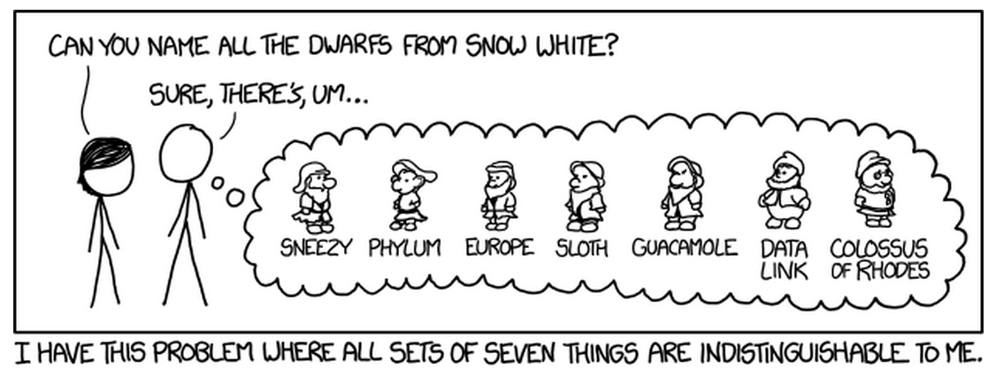
Lists
Presentation for use with the textbook Algorithm Design and Applications, by M. T. Goodrich and R. Tamassia, Wiley, 2015
xkcd “Seven” http://xkcd.com/1417/
Used with permission under Creative Commons 2.5 License

Slide 29
Lists
Stack and Queues store/remove elements to a linear sequence on the ends of the sequence.
Lists maintain linear orders but allows for access and update in the “middle” of the sequence.

Slide 30
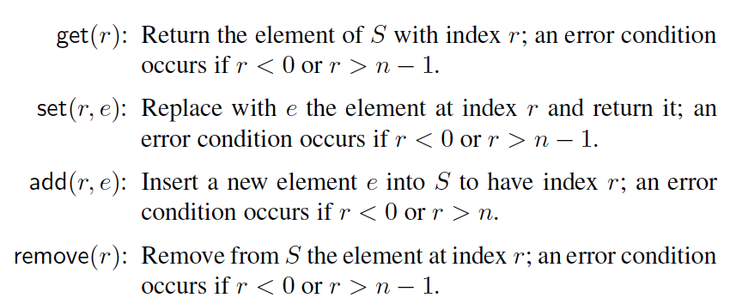
Index-Based Lists
An index-based (aka rank-based) list supports the following operations:
Note that the index is different than the array
List is dynamic, index of an element can change
While the index of an array is static

Slide 31
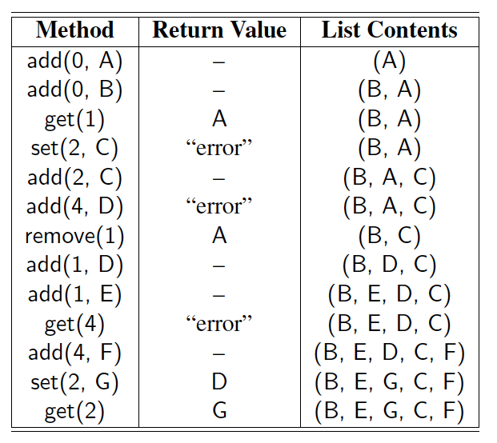
Example
A sequence of List operations:

Slide 32
Array-based Lists
An obvious choice for implementing the list ADT is to use an array, A, where A[i] stores (a reference to) the element with index i.
With a representation based on an array A, the get(i) and set(i, e) methods are easy to implement by accessing A[i] (assuming i is a legitimate index).
A
0
1
2
i
n

Slide 33
Insertion
In an operation add(i, o), we need to make room for the new element by shifting forward the n − i elements A[i], …, A[n − 1]
In the worst case (i = 0), this takes O(n) time
A
0
1
2
i
n
A
0
1
2
i
n
A
o
0
1
2
i
n

Slide 34
Element Removal
In an operation remove(i), we need to fill the hole left by the removed element by shifting backward the n − i − 1 elements A[i + 1], …, A[n − 1]
In the worst case (i = 0), this takes O(n) time
A
o
0
1
2
i
n
A
0
1
2
i
n
A
0
1
2
i
n

Slide 35
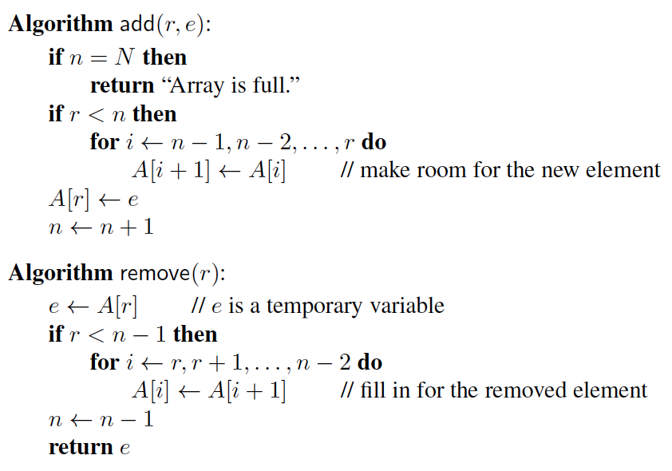
Pseudo-code
Algorithms for insertion and removal:

Slide 36
Performance
In an array-based implementation of a dynamic list:
The space used by the data structure is O(n)
Indexing the element at i takes O(1) time
add and remove run in O(n) time in the worst case
In an add operation, when the array is full, instead of throwing an exception, we can replace the array with a larger one.

Slide 37
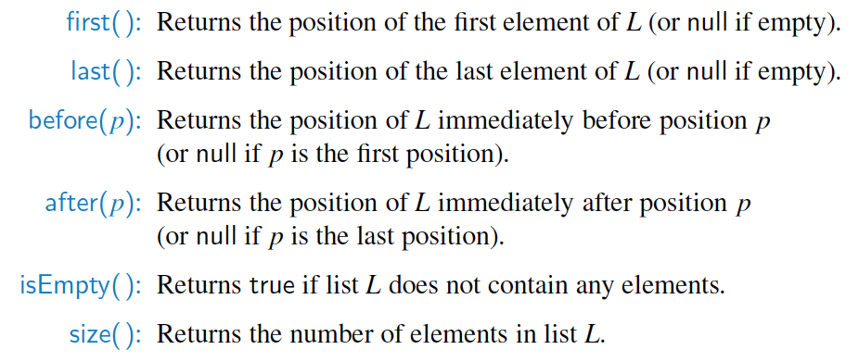
Linked Lists
Linked lists store elements at “nodes” or “positions”.
Accessor methods:

Slide 38
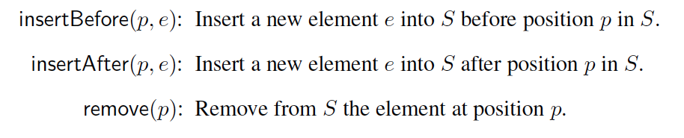
Linked Lists
Update methods:
Implementation:
The most natural way to implement a positional list is with a doubly-linked list.
prev
next
header
nodes/positions
trailer
element
node
elements
Lists and Iterators
38

Slide 39
Insertion
Insert a new node, q, between p and its successor.
p
A
B
C
p
A
B
q
C
X
p
q
A
B
X
C

Slide 40
Deletion
Remove a node, p, from a doubly-linked list.
p
A
B
C
D
A
B
C
p
D
A
B
C

Slide 41
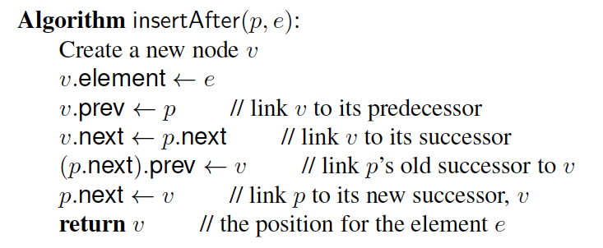
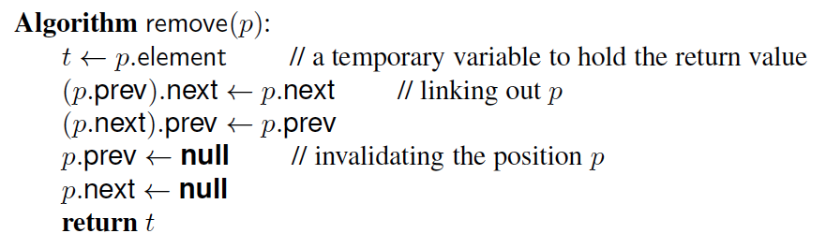
Pseudo-code
Algorithms for insertion and deletion in a linked list:

Slide 42
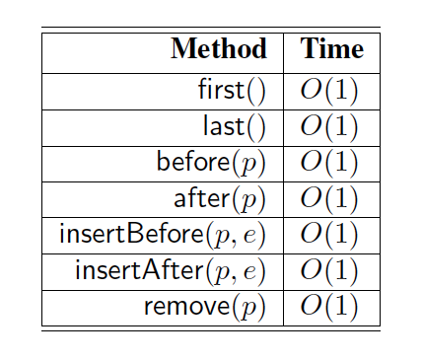
Performance
A linked list can perform all of the access and update operations for a positional list in constant time.

Slide 43
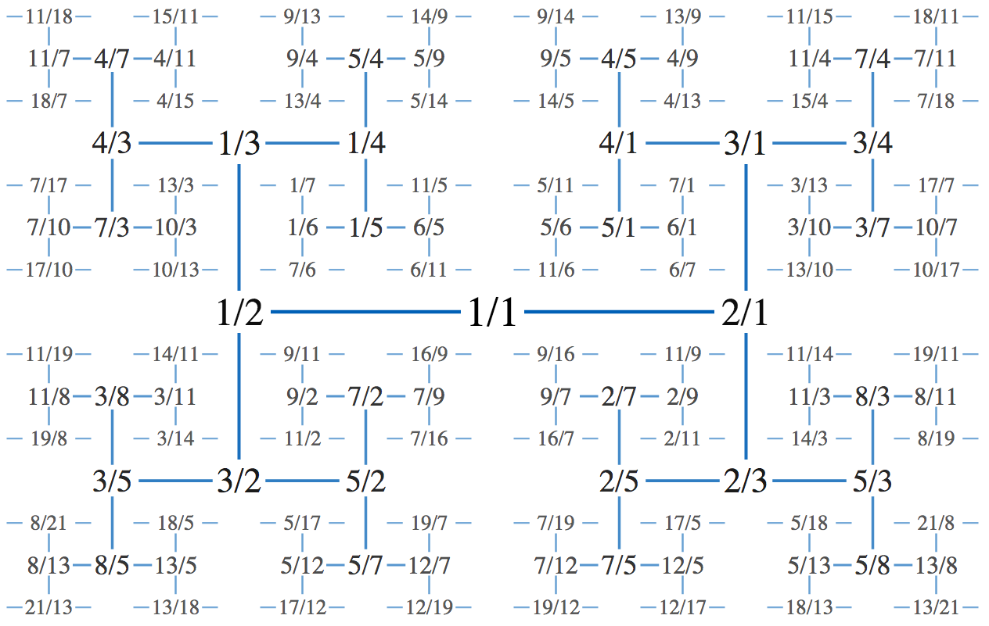
Trees
Presentation for use with the textbook Algorithm Design and Applications, by M. T. Goodrich and R. Tamassia, Wiley, 2015
The Calkin–Wilf tree, drawn using an H tree layout.
David Eppstein, 2009. Public-domain image.

Slide 44
What is a Tree?
In computer science, a tree is an abstract model of a hierarchical structure
A tree consists of nodes with a parent-child relation
Applications:
Organization charts
File systems
Programming environments
Computers”R”Us
Sales
Manufacturing
R&D
US
International
Laptops
Desktops
Europe
Asia
Canada

Slide 45
Tree Terminology
Root: node without parent (A)
Internal node: node with at least one child (A, B, C, F)
External node (a.k.a. leaf ): node without children (E, I, J, K, G, H, D)
Ancestors of a node: parent, grandparent, grand-grandparent, etc.
Depth of a node: number of ancestors
Height of a tree: maximum depth of any node (3)
Descendant of a node: child, grandchild, grand-grandchild, etc.
Subtree: tree consisting of a node and its descendants
A
subtree
B
C
D
E
F
G
H
I
J
K

Slide 46
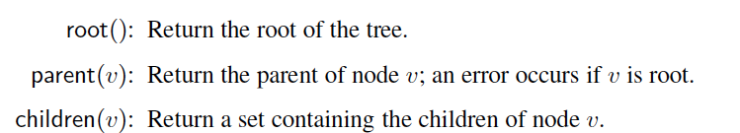
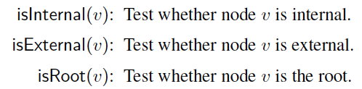
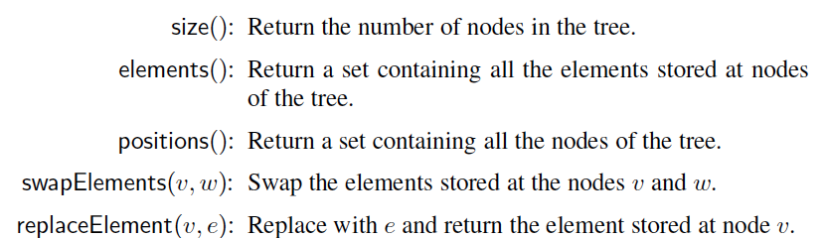
Tree Operations
Accessor methods:
Query methods:
Generic methods:

Slide 47
Preorder Traversal
A traversal visits the nodes of a tree in a systematic manner
In a preorder traversal, a node is visited before its descendants
Application: print a structured document
Algorithm preOrder(v)
visit(v)
for each child w of v
preorder (w)
1
Make Money Fast!
2
5
9
1. Motivations
2. Methods
References
3
4
6
7
8
1.1 Greed
1.2 Avidity
2.1 Stock Fraud
2.2 Ponzi Scheme
2.3 Bank Robbery

Slide 48
Postorder Traversal
In a postorder traversal, a node is visited after its descendants
Application: compute space used by files in a directory and its subdirectories
Algorithm postOrder(v)
for each child w of v
postOrder (w)
visit(v)
9
cs16/
8
3
7
homeworks/
programs/
todo.txt 1K
1
2
4
5
6
h1c.doc 3K
h1nc.doc 2K
DDR.java 10K
Stocks.java 25K
Robot.java 20K

Slide 49
Binary Trees
A binary tree is a tree with the following properties:
Each internal node has at most two children (exactly two for proper binary trees)
The children of a node are an ordered pair
We call the children of an internal node left child and right child
Alternative recursive definition: a binary tree is either
a tree consisting of a single node, or
a tree whose root has an ordered pair of children, each of which is a binary tree
Applications:
arithmetic expressions
decision processes
searching
A
B
C
D
E
F
G
H
I

Slide 50
Arithmetic Expression Tree
Binary tree associated with an arithmetic expression
internal nodes: operators
external nodes: operands
Example: arithmetic expression tree for the expression (2 × (a − 1) + (3 × b))
+
×
×
2
−
3
b
a
1

Slide 51
Decision Tree
Binary tree associated with a decision process
internal nodes: questions with yes/no answer
external nodes: decisions
Example: dining decision
Want a fast meal?
Yes
No
How about coffee?
On expense account?
Yes
No
Yes
No
Starbucks
Chipotle
Gracie’s
Café Paragon

Slide 52
Properties of Proper Binary Trees
Notation
n number of nodes
e number of external nodes
i number of internal nodes
h height
Properties:
e = i + 1
n = 2e − 1
h ≤ i
h ≤ (n − 1)/2
e ≤ 2^{h}
h ≥ log₂ e
h ≥ log₂ (n + 1) − 1

Slide 53
Binary Tree Operations
A binary tree extends the Tree operations, i.e., it inherits all the methods of a Tree.
Additional methods:
position leftChild(v)
position rightChild(v)
position sibling(v)
The above methods return null when there is no left, right, or sibling of p, respectively
Update methods may be defined by data structures implementing the binary tree

Slide 54
Inorder Traversal
In an inorder traversal a node is visited after its left subtree and before its right subtree
Application: draw a binary tree
x(v) = inorder rank of v
y(v) = depth of v
Algorithm inOrder(v)
if left (v) ≠ null
inOrder (left (v))
visit(v)
if right(v) ≠ null
inOrder (right (v))
6
2
8
1
4
7
9
3
5

Slide 55
Print Arithmetic Expressions
Specialization of an inorder traversal
print operand or operator when visiting node
print “(“ before traversing left subtree
print “)“ after traversing right subtree
Algorithm printExpression(v)
if left (v) ≠ null print(“(’’)
inOrder (left(v))
print(v.element ())
if right(v) ≠ null
inOrder (right(v))
print (“)’’)
+
×
×
2
−
3
b
((2 × (a − 1)) + (3 × b))
a
1

Slide 56
Evaluate Arithmetic Expressions
Specialization of a postorder traversal
recursive method returning the value of a subtree
when visiting an internal node, combine the values of the subtrees
Algorithm evalExpr(v)
if isExternal (v)
return v.element ()
else
x ← evalExpr(left(v))
y ← evalExpr(right(v))
◊ ← operator stored at v
return x ◊ y
+
×
×
2
−
3
2
5
1

Slide 57
Euler Tour Traversal
Generic traversal of a binary tree
Includes a special cases the preorder, postorder and inorder traversals
Walk around the tree and visit each node three times:
on the left (preorder)
from below (inorder)
on the right (postorder)
+
L
×
R
×
B
2
−
3
2
5
1

Slide 58
Linked Structure for Trees
A node is represented by an object storing
Element
Parent node
Sequence of children nodes
Node objects implement the Position ADT
∅
B
∅
∅
A
D
F
B
A
D
F
C
E
∅
∅
C
E

Slide 59
Linked Structure for Binary Trees
A node is represented by an object storing
Element
Parent node
Left child node
Right child node
Node objects implement the Position ADT
∅
B
∅
∅
B
A
D
A
D
∅
∅
∅
∅
C
E
C
E

Slide 60
Array-Based Representation of Binary Trees
Nodes are stored in an array A
0
A
A
B
D
…
G
H
…
1
2
0
1
2
9
10
B
D
Node v is stored at A[rank(v)]
rank(root) = 0
if node is the left child of parent(node), rank(node) = 2 ⋅ rank(parent(node)) + 1
if node is the right child of parent(node), rank(node) = 2 ⋅ rank(parent(node)) + 2
3
4
5
6
E
F
C
J
9
10
G
H

Slide 61
About Stevens
A premier, private research university with a mission to inspire, nurture and educate leaders in tomorrow’s technology-centric environment while contributing to the solution of the most challenging problems of our time

